Slide 1

HEALTH-SYNERGY (TELEHEALTH PLATFORM)

Slide 2

CONTENTS
Introduction
STATICAL INSIGHTS
“WELCOME TO HELATH SYNERGY”
“BEHIND BUZZ”
PURPOSE
PROS AND CONS
BEHIND THE SCENES
BREAKING BARRIERS

Slide 3

Introduction
In this era, marked by technological advances and a growing emphasis on wellness of oneself, this platform stands as an intersection of healthcare and digital innovation. This is an exploration into a pioneering telehealth platform that redefines how we tackle health concerns using at-home remedies tailored to individual needs.
This report is an exploration into a pioneering telehealth platform that redefines how we tackle health concerns using at-home remedies tailored to individual needs.

Slide 4

STATASTICAL INSIGHTS:-
Telecommunication technologies in the healthcare industry are evolving like never before. Let us delve into some key insights of the telehealth and medicine market.
Principle Telehealth DomAINS :-
➢ Live video-conferencing
➢ Without the real-time intervention, the patient’s medical information is transmitted through E communication to the care-provider.
➢ Remote Patient Monitoring (RPM)
This Photo by Unknown Author is licensed under CC BY-NC

Slide 5
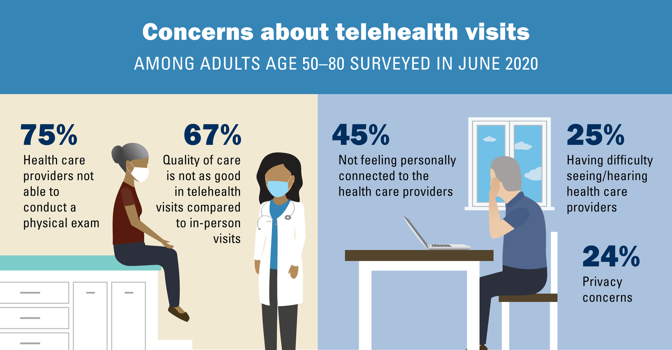
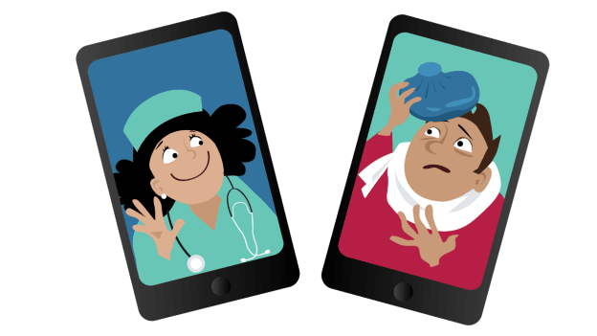
Telehealth during Pandemic:
➢ Due to the pandemic, many telehealth providers have reported growth in their demand
Purpose of telehealth app:
According to the Telehealth Index: 2019 Consumer Survey, about 66% of patients are willing to use virtual care, and 8% have tried it. Among patients who are willing to use connected health,
▪ 61%; use it for convenience and faster service, and
▪ 54%; use it to save money.
This Photo by Unknown Author is licensed under CC BY-NC

Slide 6
TELEHEALTH PLATFORM
Welcome to Health Synergy – Your Personalized Wellness Journey
At Health Synergy, we redefine healthcare because your well-being is our top-most priority. Our telehealth and medicine platform not only stands for treating symptoms; it's a holistic experience tailored to help you on your journey to optimal health.
How It Works?
Symptom Analysis
~ Begin by inputting your symptoms into our website . ~ We dive deep into the problem , providing a comprehensive analysis to understand your unique health profile.
Diet Chart Precision
~ Our nutritionists craft patient-catered diet charts based on your health goals, preferences, and requirements.
Guided Exercise Routines
~ Elevate your fitness with top-notch exercise routines. Whether you're a beginner or a fitness enthusiast, our platform guides you through workouts designed exclusively for you

Slide 7
Why Health Synergy?
Holistic Approach: - Addresses the root of the issue, not just the symptom.
Personalized Care: - Designed to your unique health profile and goals.
Accessible Wellness: - Get healthier from anywhere, at any time. One can access our website irrespective of factors like time, geographical area.
Your Wellness, Your Way!
Health-Synergy is not just a platform, it’s a partner in your wellness journey. Take charge of your health today and embark on a path to a healthier, happier you.

Slide 8
“BEYOND THE BUZZ” What Sets Our Website Apart in a Crowded Digital Landscape
Holistic Approach to Health: Our platform integrates a comprehensive approach, offering not only telehealth services but also personalized recommendations for diet, exercise, and holistic wellness. These features collectively highlight the holistic approach.
Personalization and Customization: Our website provides highly personalized recommendations based on individual health profiles, preferences, and goals. Often users appreciate custom-made solutions that meet their unique needs.
User-Friendly Interface: We ensure to provide an intuitive and user-friendly interface. Easy navigation, clear instructions, and seamless user experience contribute to user satisfaction and can set our platform apart.
Accessible and Inclusive: We plan to establish this website and ensure accessibility to rural areas. Our platform addresses the needs of individuals in rural or underserved areas. It would also meet the needs of users with varying levels of technological literacy.
Innovative Technology: Our platform incorporates innovative technologies, such as advanced symptom analysis tools, AI driven recommendations, or telehealth advancements, that enhance the user experience.
Community and Support: Building a strong community and robust support system sets it apart from another website. Our platform fosters a sense of community, where users can interact, share experiences, and support each other. Our website cultivates a profound sense of community and provides a robust platform for mutual support.
Education and Empowerment: Our platform educates users about their health conditions, preventive measures, and wellness practices. Empowering users with knowledge contribute to long-term engagement
Partnerships and Integration: Integrations can enhance the overall healthcare experience. Hence, we plan to provide collaborations with various other health-apps, healthcare providers and organizations

Slide 9
MOTIVATION BEHIND DEVELOPING THIS WEBSITE:
Improving Accessibility: Our main motive is to acknowledge the importance of accessible healthcare, especially in remote or underserved areas. It aims to bridge the gap; geographical and physical barriers.
Holistic Health Approach: To embrace a holistic approach to health, our platform likely aims to address not only symptoms but also factors such as nutrition and exercise, recognizing the correlation of physical and mental well-being.
Technology for Positive Impact: With rapid advance in technology, it becomes crucial to make some positive impact in and around. The potential of digital solutions is enhancing the healthcare experience, making it more convenient, personalized, and effective.
Innovation in Healthcare: A keenness to contribute to the innovation and evolution of healthcare services by introducing pioneering tactics, such as symptom analysis, personalized recommendation, guided exercise routines, and telehealth consultations.
Response to Changing Needs: Recognizing the changing landscape of healthcare needs, especially in the context of global events or health crises, we have developed this platform to address emerging challenges and adapt to the evolving needs of users. (PANDEMIC

Slide 10
NAVIGATING OPTIONS
PROS: -
• Accessibility: Provides access to medical care for any individual, irrespective of their location, be it an urban or a remote area.
• Convenience: Allows patients to schedule appointments more easily and is also convenient for people with mobility issues, as it offers complete flexibility to the users.
• Cost Savings: Reduces the travel expenses thereby, lowers the healthcare costs.
• Efficiency: Can be more time efficient for both healthcare providers and patients.
• Preventive Care: Preventive care is guaranteed by enabling regular check-ups.
• Reduced exposure to infection: By minimizing the personal visits with doctors, it reduces the chances of infections especially during pandemics.
• Monitoring and chronic care: It helps the healthcare providers track vital signs of a patient, and adjust treatment accordingly.
CONS: -
• Technological barriers: Some patients may lack the technological resources such as phone, computer, internet access etc.
• Lack of physical examination: Virtual visits limit the healthcare provider’s capability to conduct a thorough physical examination that could lead to misdiagnosis.
• Security and privacy concerns: Telehealth platforms need robust security measures to hide patient data and maintain sequestration.
• Insurance Coverage and Reimbursement: Reimbursement policies for telehealth services can be inconsistent.
• Limited Emergency Care: A telehealth platform cannot replace emergency situations where hands-on care is required. • Regulatory challenges: Different regions have varying regulations for telemedicine that could pose a challenge for providers offering services across multiple governance.
• Technological Glitches: Technical issues, such as poor internet connectivity or software may disrupt the consultation.

Slide 11
BEHIND THE SCENES PROBLEMS FACED WHILE MAKING THE WEBSITE
Problem 1: TO make the website Learning of website from scratch within stipulated time was quite challenging as it requires to ace some skills.
Solution: we learnt html, CSS and JavaScript along with bootstrap.
Problem 2: Problem in design layout Did not know how to design a Telehealth website.
Solution: we had to go through other websites to draw inspiration for website design.
Problem 3: Standing out There are a lot of Telehealth websites so we had to stand out amongst them.
Solution: what we did is we made it much more user friendly compared to other websites, added features like a virtual waiting room, optimized smartphone and 24/7 availability. We have also collaborated on different features like symptom analysis, medicine recommendations and diet plan, making it versatile.
Problem 4: Role based control To make the website role based, meaning they should be different for doctors, nurses, and patients, we had to create roles/id. Problem 5: User-Interface Complexity To build an intuitive and user-friendly platform for complex data can be quite challenging.
Solution: Firstly, conduct a session with the user to understand his needs better. Then, prioritize the vital information and use clear and simple visualizations to display the data

Slide 12
FUTURE SCOPE
▪ Enhanced AI and Personalization: Platform's AI capabilities should be upgraded to offer more personalized recommendations based on user health reports and preferences. This can be done by refining the algorithms to provide accurate and tailored advice.
▪ Integration with Wearable Devices and IoT: Integrating health and IoT (Internet of Things) gadgets to gather real-time health data. IoT device can gather data and provide a much more compressive report using real time data and cloud servers.
▪ Gamification and Behavioral Incentives: Gamification elements must be included to encourage using the platform and adherence to medical suggestions. Using rewards and challenges to motivate users in following prescribed remedies and lifestyle changes.
▪ Community and User Engagement Features: A community should be established within the platform, allowing the users to share experiences and tips.
▪ Augmented Reality (AR) and Virtual Experiences: VR features could be added for virtual healthcare experiences, enabling users to simulate health-related scenarios or take part in VR appointments for procedures like home first aid, physical therapy exercises, etc

Slide 13
“BREAKING BARRIERS”
HOW TO MAKE OUR WEBSITE ACCESSIBLE TO RURAL RESIDENTS?
To ensure that our telehealth and medicine website is accessible to people residing in rural areas requires addressing challenges such as limited internet connectivity, lower technological literacy, and potential barriers to healthcare access. Here are some strategies to enhance accessibility for users in rural areas:
➢ Optimize for Low Bandwidth: By designing the website to be lightweight and optimized for low bandwidth, it ensures that users with slower internet connections can still have access to essential features without delays.
➢ Text-Heavy Alternatives: By providing text-heavy alternatives for graphics and videos, it can help users with low bandwidth , access information more efficiently, as text content generally requires less bandwidth.
➢ Clear Instructions and Guidance: By using simple language and straightforward navigation, we can ensure that our website provides clear instructions and guidance for users who may have lower technological literacy.

Slide 14
➢ Localized (something): Tailored content is added to make relevant changes based on healthcare needs of individuals in rural areas. Information on common health issues in these regions and relevant preventive measures is thrown in. ➢ Community Outreach: Community outreach initiatives are organized to raise awareness. Collaborations with local organizations, community leaders, and healthcare providers are established in order to promote the platform and help the users get familiar with the working ➢ Alternate Communication Channels: Helpline or email support are made readily available, for users who may face challenges using the website. This enables them to comfortably seek for help whenever required. ➢ Local Language Support: Availability of helpline and support through local languages enhances accessibility and ensures that users can navigate smoothly and understand the content more effectively. ➢ Offline Resources: By Providing downloadable resources, such as health guides, educational materials, or forms, users can access them offline and refer to as needed ➢ Collaborate with Local Healthcare Providers: By establishing partnerships with local healthcare providers or clinics in rural areas. This collaboration can help bridge the gap between online and offline healthcare services, providing users with a more comprehensive healthcare experience.

Slide 15




Meet our team
NAGAVARAM ASHRITH
MOHAMMED ZIYAD
KAVYA HEMANTH
MAANASTEJ BIRUDUKOTA

Slide 16


Thank you

